Slide 1

TEAM LUFFY Online Nursery Marketplace with Intelligent Plant Recognition and Care Recommendations Team Members -Abhinaya S (MLmodelTrainer) -Anjana B (BackEnd Developer) -Sabthagiri S (FrontEnd Developer)

Slide 2
USECASE:
In the online nursery marketplace the customer can buy or sell
the plants ,gardening supplies.
Users can browse and search for plants.
When the users upload the plant image the AI system automatically scans and provides the care tips.
AI related Problem:
The AI-related problem to be solved is identifying plant species accurately from user-uploaded images.
This system aims to provide tailored care recommendations based on the plant's specific needs.

Slide 3
OBJECTIVES:
Checkpoint 1 - Implement the user authentication and registration process.
Checkpoint 2 - Develop plant marketplace features for browsing, purchasing, and plant listing creation.
Checkpoint 3 - Implement the AI model for plant recognition and also develop an UI for image uploading and to display the results.
Checkpoint 4 - Create personalized care recommendations based on plant type and user conditions.
Checkpoint 5 - Build order management features for tracking and managing purchases, and implement user reviews and ratings functionalities.
Checkpoint 6 - Integrate the system with vendor management tools and analytics, develop a feedback mechanism for user input and system improvement.

Slide 4
PLAN TO TACKLE THE PROBLEM
Focus on data collection for building a comprehensive plant database, followed by model development for plant recognition and care recommendations.
MACHINE LEARNING MODELS
Convolutional Neural Networks (CNNs) for plant image recognition.
Natural Language Processing (NLP) for understanding user queries and generating care recommendations.
SOFTWARE AND TOOLS
Programming Language: Python
Frontend Framework: React.js
Database: MongoDB

Slide 5
EXECUTION PLAN
Checkpoint 1: Implement user authentication and registration.
Checkpoint 2: Develop features for browsing, purchasing, and plant listing creation.
Checkpoint 3: Implement AI model for plant recognition and create an image upload UI.
Checkpoint 4: Create personalized care recommendations based on plant type and user conditions.
Checkpoint 5: Build order management features and implement user reviews and ratings.
Checkpoint 6: Integrate vendor management tools, analytics, and a feedback mechanism for improvement.
TEAM MEMBER ROLES
Member 1: ML model trainer
Member 2: Frontend developer
Member 3:Backend developer

Slide 6
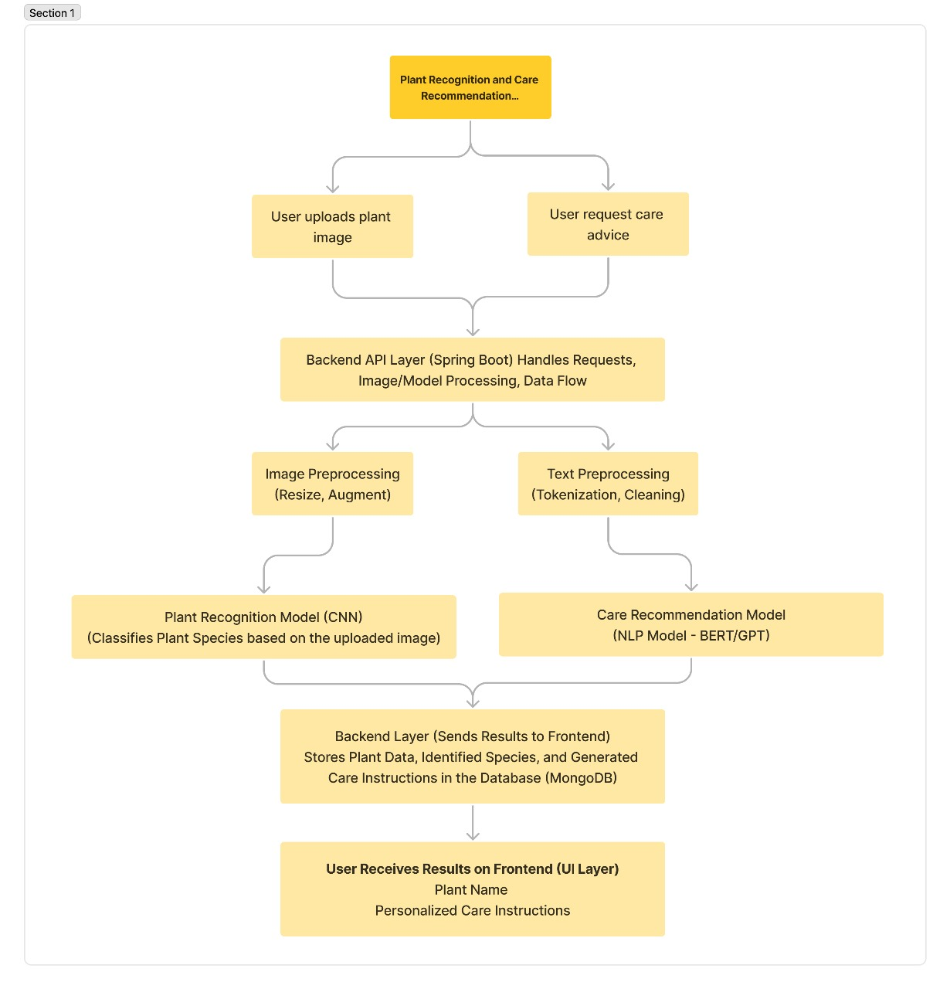
ARCHITECTURE

Slide 7
DATASOURCES
Plant Image Database:
1.PlantNet
2.iNaturalist
Plant Care Information:
1.Royal Horticultural Society
2.Gardening Know How

Slide 8
MODEL SELECTION
GPT (Generative Pre-trained Transformer) - NLP model that uses transformer architecture for text generation and understanding through pre-training on large text datasets.
ResNet (Residual Networks) - deep CNN model that uses residual connections to enable efficient training of very deep networks, commonly used in image classification tasks.
EVALUATION
GPT models can achieve around 85-95% accuracy.
GPT models precision ranges from 85-95%.
ResNet models can achieve around 90-99% accuracy.
ResNet models precision range from 95-99%.

Slide 9
CHALLENGES
Large models require high resources.
Achieving high accuracy can be tough. Improve through hyperparameter tuning and fine-tuning models.
Limited or imbalanced data affects model performance. Mitigate with data augmentation and using high-quality datasets.
MITIGATION
Fine-tune pre-trained models like GPT and ResNet to save computational costs and time.
Optimize parameters such as learning rate and batch size to improve model accuracy.
Increase dataset size and diversity by generating synthetic data or applying transformations.

Slide 10
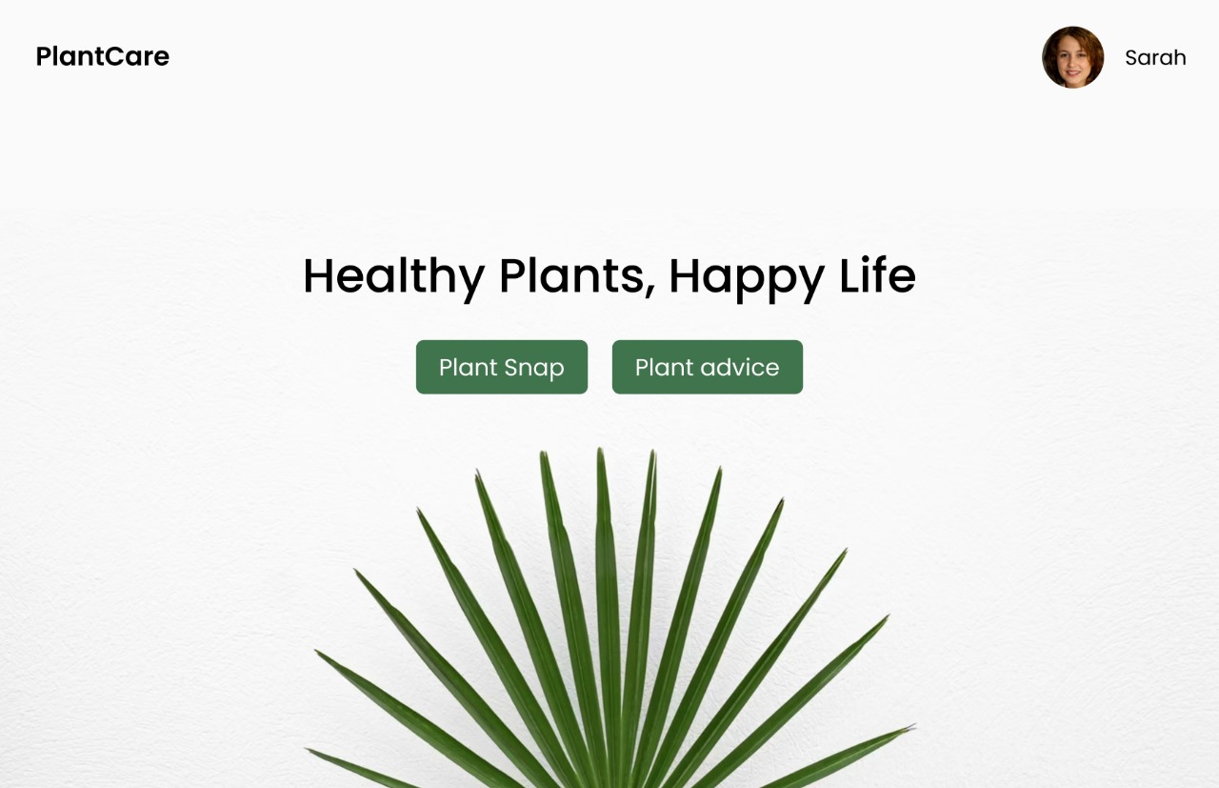
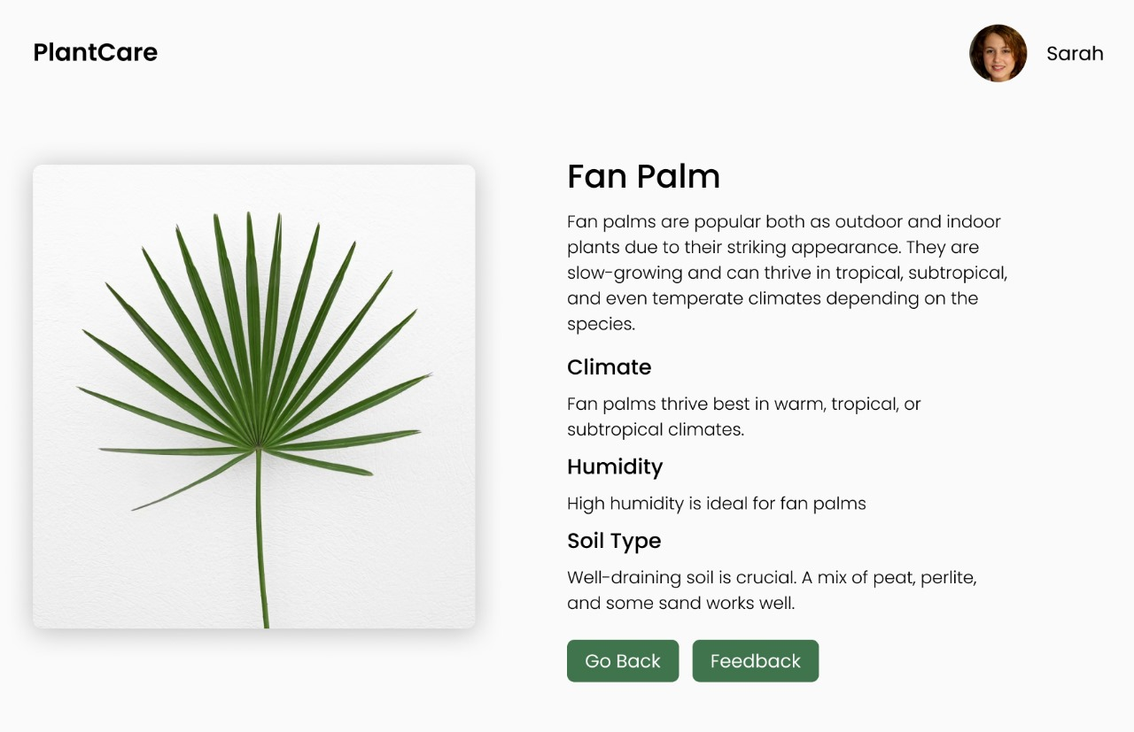
EXPECTED OUTCOMES
The outcome reflects in plant purchasing with accurate AI-powered plant recognition and personalized care recommendations. Nursery owners can manage their listings efficiently, while users benefit from a smooth shopping experience, care advice, and customer reviews. The AI system will continuously improve through user interactions, enhancing both recognition accuracy and care recommendations.

Slide 11
CONCLUSION
The Online Nursery Marketplace is a platform designed to connect customers with nursery owners for purchasing plants and gardening supplies.
It features an AI-powered plant recognition system that identifies plant species from user-uploaded images and provides personalized care recommendations.
Key actors include users (customers), nursery owners (vendors), and system admins who manage accounts and ensure smooth operations. The marketplace offers plant browsing, purchasing, care advice, and vendor management tools.
The AI system improves with user interactions, enhancing the accuracy of plant recognition and care recommendations. Challenges such as data quality, overfitting, and scalability are addressed with strategies like data augmentation, regularization, and model optimization.

